Slide 1
Project Definition
by Matt Raporte and Greg Potter

Slide 2
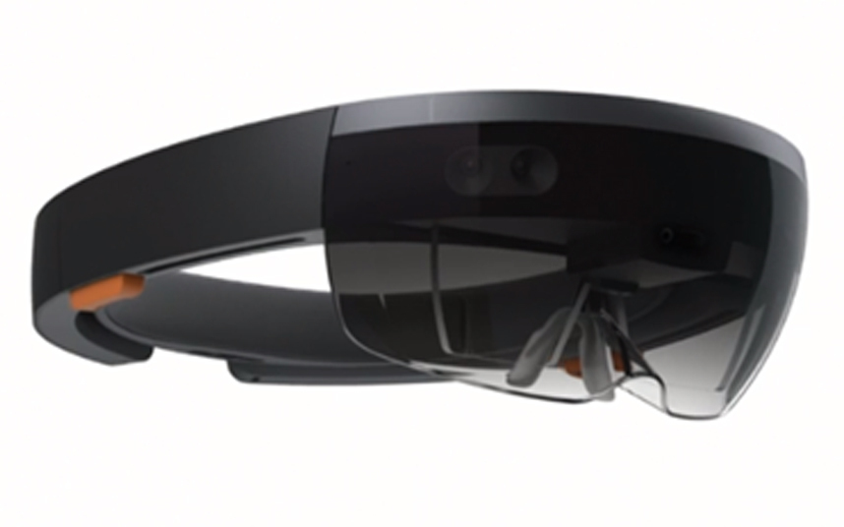
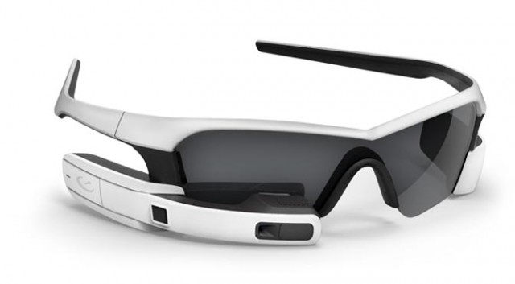
Problem:
>800$
1500$

Slide 3
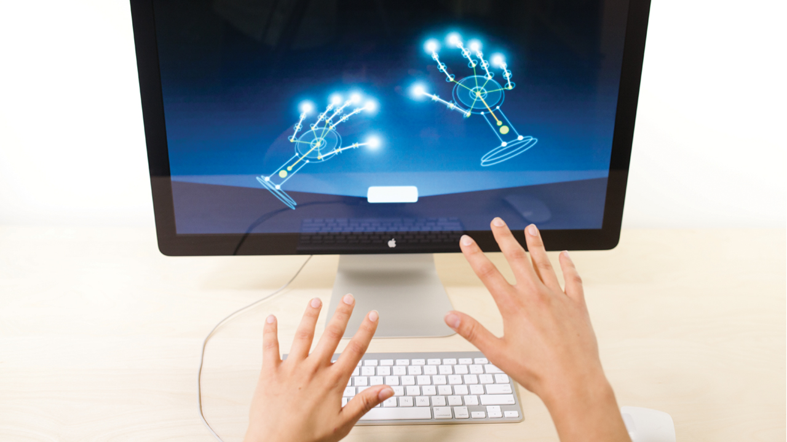
70$

Slide 4
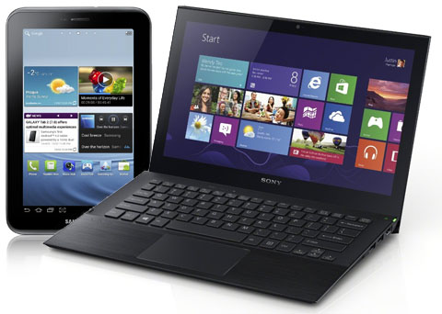
Why is it interesting/important:
If we can create a cheap, effective and useful way to incorporate this technology with an existing product (such as a laptop computer or a PC) it could be one of the first “household” applications of an emerging technology

Slide 5
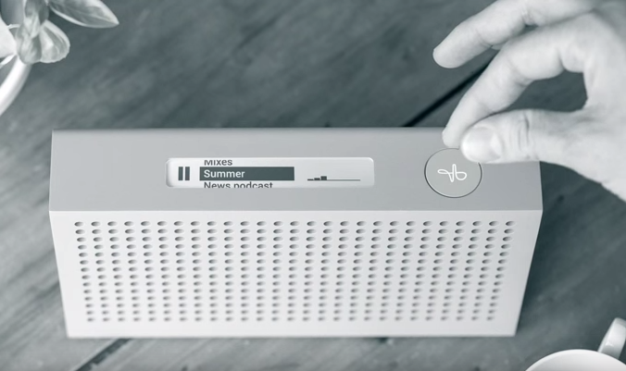
Google’s Project Soli

Slide 6
Clear enumeration of customer requirements:
Clear enumeration of customer requirements:
Minimum scope you must accomplish to meet customer requirements (and pass the course):
Using the Leap Motion Controller and the Windows API, allow users to move windows, perform basic scrolling functionality, and advance slides in PowerPoint.
Remaining (desired) project deliverables prioritized if possible:
Integrate with Windows logon to allow for “3D gesture passwords”
Allow users to adjust volume, brightness, and other features
Create a cursor so that the user can click on items on the screen controlled by motion
Create a virtual keyboard (or handwriting recognition) to allow for text input when necessary
Allow two users to use the computer together

